Slide 1
Wireless Project
Group 11:
Drishti Singh - MT23117
Shivam Agarwal - 2020123
Prerna Tyagi - MT23131
Deepesh Kumar - 2019159

Slide 2
Title
To understand the performance difference between IPv4 and IPv6 and also their respective latency for the concerned websites while using different network carriers like Jio, Airtel and VI, and to see how the geolocation of the pinged servers and network topology impact the performance.

Slide 3
Key Deliverables
Collecting the data for each of the 100 websites which are both IPv4 and IPv6 enabled through the ping module of the Linux, using different network carriers (Airtel, Vi and Jio) for over a week.
Obtaining the geolocation of the servers using its IP address (both IPv4 and IPv6).
Obtaining traceroute data and information about the number of hops using the traceroute command.
Analysis of the performance of IPv4 and IPv6 over various parameters.

Slide 4
Phase I: Collecting Data
First top 130 websites were chosen (top websites listed and Alexa and some government and Institute websites)
An automated script was created using multi-threading concept to capture the following details (for each day, for each website, for both IPv4 and IPv6)
i. Get the ISP name using whatismyisp.com
ii. Ping each website 40 times with packet size 10 and collect the RTTs for each ping.
iii. Collect geolocation of the IP address using ipinfo.io
iv. Send traceroute request to the IP address and collect the data
v. Use multithreading to send pings requests to 10 websites simultaneously to reduce the collection time.
vi. After multi threading, our time for each session was around 2.5 hrs.
vii. The data is stored in mongo db containers in json format.

Slide 5
Phase II: Data Refinement
First, all the csv files were merged together for both IPv4 and IPv6.
All the empty values were replaced by NaN in the sheet.
The date column was formatted (Current format: YYYY-MM-DD)
Since there were some websites which were lossy, we found all those websites which were common in both IPv4 and IPv6 for all days and all ISPs.
For all those websites whose ping didn’t work even for one time, they were removed from both the files.
To the find the top 100 optimal websites to proceed with, following steps were used:
i. Average of MAX RTTs was calculated for each website in IPv4 and IPv6 combined.
ii. Scatter plot was created to find the outliers.
iii. The ones in the optimal range were chosen.

Slide 6
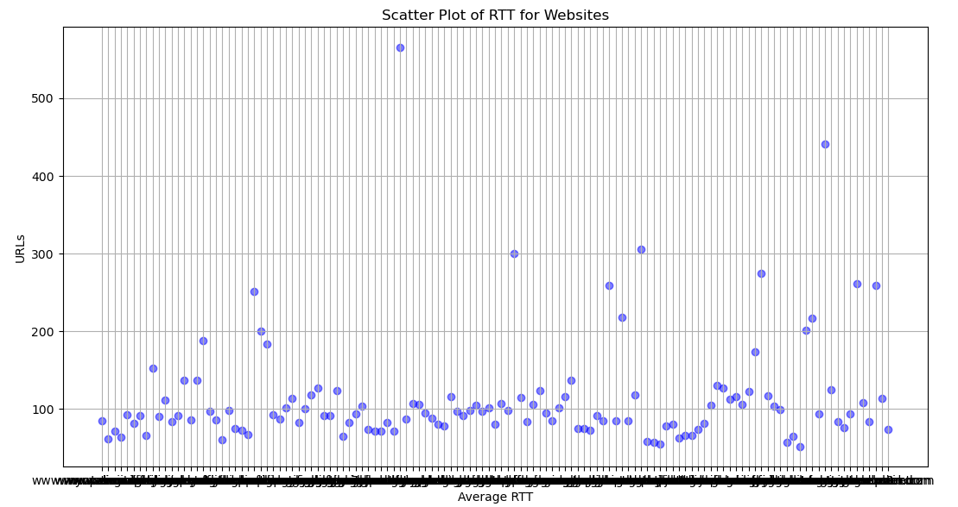

Slide 7
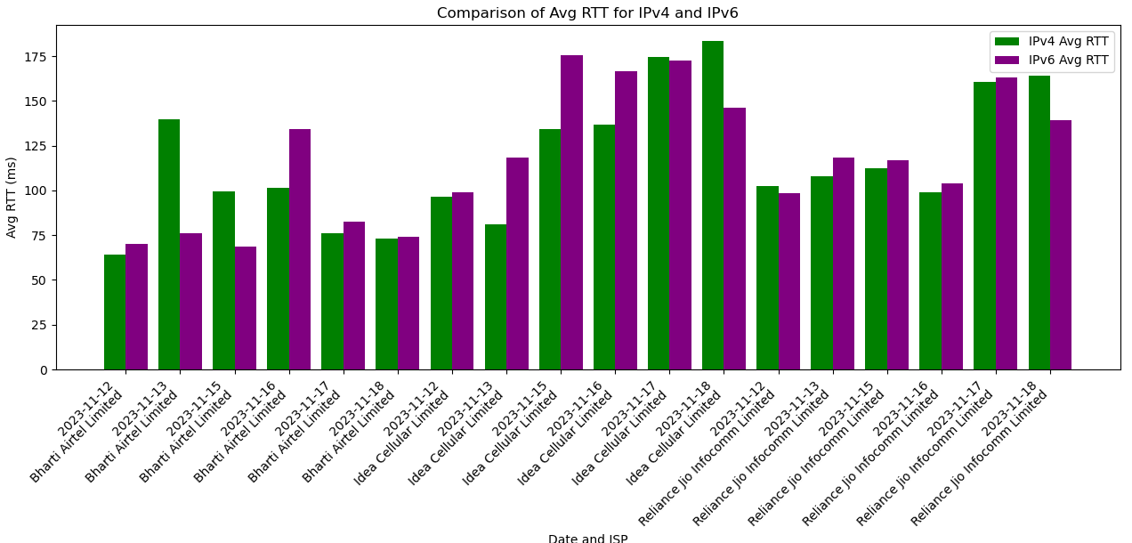
Phase III: Analysis
1. Based on Latency
There is not clear distinction between the latencies of IPv4 and IPv6
According to ISP, For Airtel, on an avg, IPv6 has more or almost the same latency as IPv4.
For VI as well, IPv6 has slightly more latency or almost the same as IPv4.
For Jio (5G), IPv6 has more latency than IPv4.

Slide 8
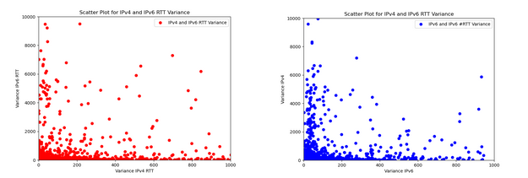
From the above scatter plots, it can be observed that the variance distribution of IPv4 and IPv6 is almost the same. But yes, if we check precisely, From 0 to 200 (in blue figure), the plot is slightly more dense than the first one, which means that IPv6 has slightly more variability than IPv4.
Also, by viewing the plot, it is inferred that IPv4 and IPv6 are negatively correlated.
Inference: In terms of latency, IPv6 is slightly less or almost same efficient as IPv4.

Slide 9
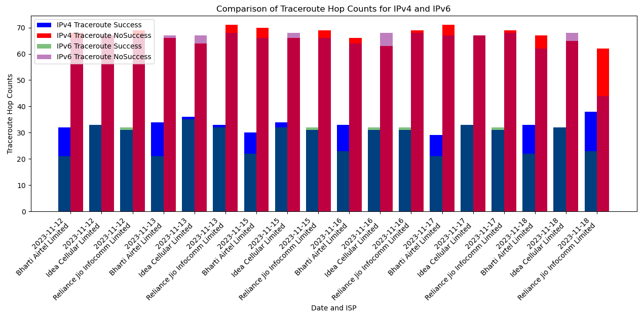
Based on Number of Hops
From the above plot, we can infer that IPv4 has more successful traceroute successes as compared to IPv6 across all the ISPs.
While for unsuccessful traceroutes, Both IPv4 and IPv6 perform the same.

Slide 10
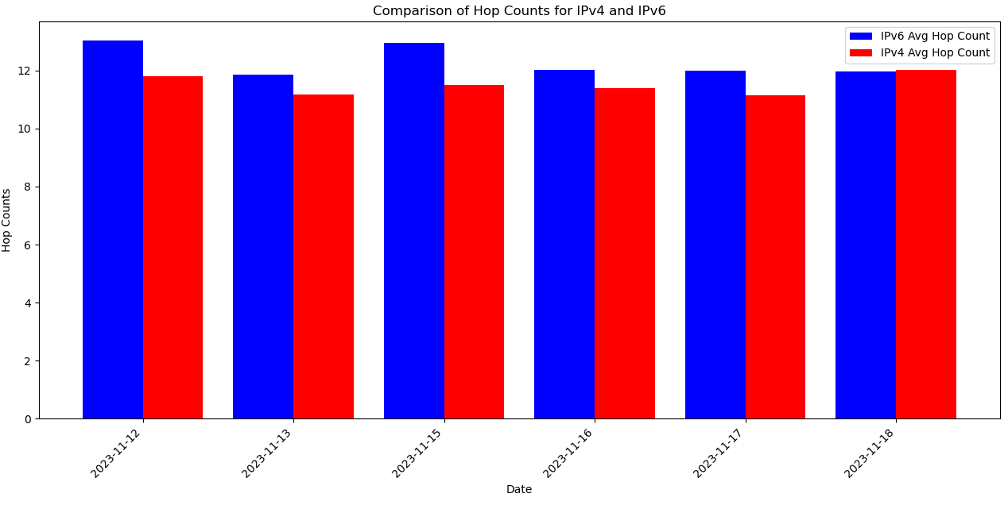
We can clearly infer from the above plot that IPv6 has more or at least as much as IPv4 hop counts as compared to IPv4.
Inference: We can infer from above plots that IPv6’s slightly more latency is due to the fact that it has more Hop counts than IPv4. Also, IPv4 is more slightly more reliable than IPv4 in terms of getting response from the server.

Slide 11

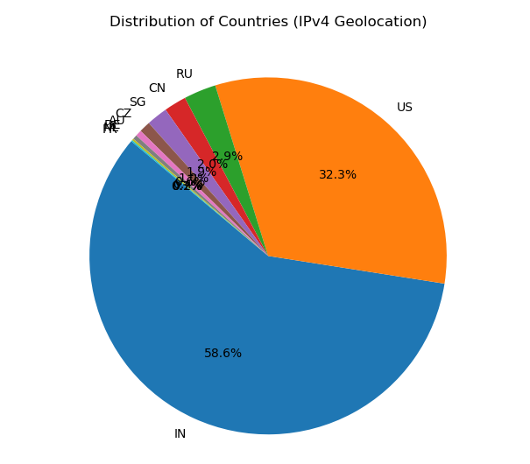
Based on Geo Location
This is the count for all those websites whose geolocation cannot be obtained from an IP address.
Clearly, geolocation accuracy of IPv6 is way less than IPv4
Number of websites of IN is max followed by US and followed by other counteries

Slide 12
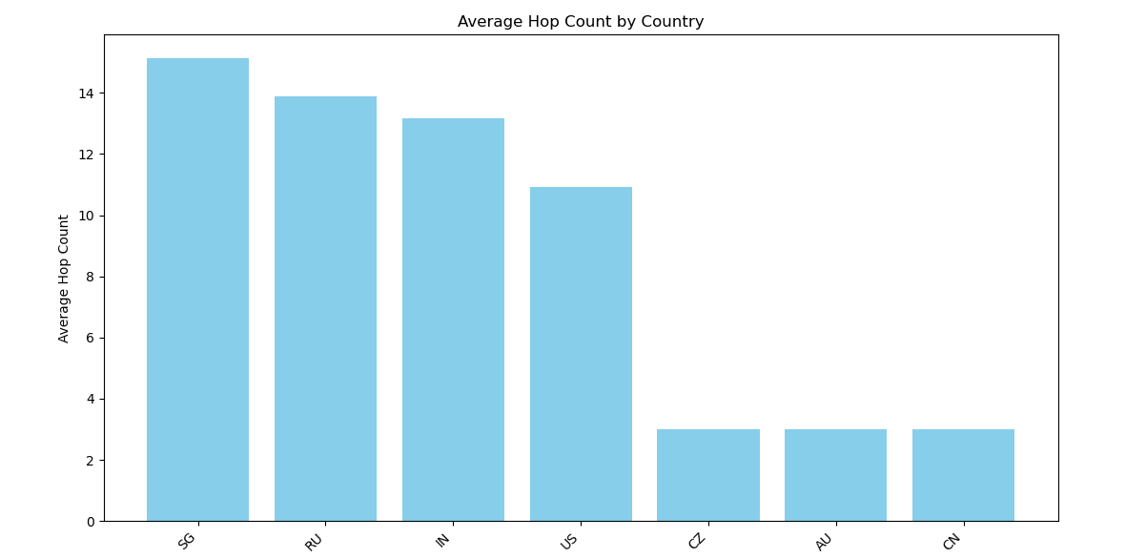
Singapore has ranked 1 in terms of highest average number of hops.

Slide 13
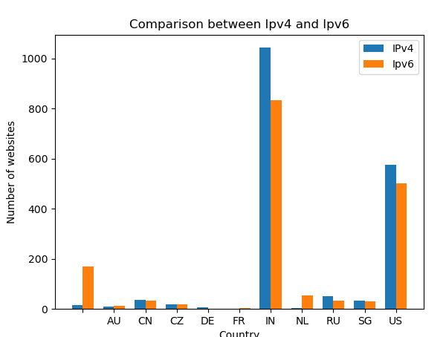
Inference: It can be inferred that almost for all countries, the reliability of IPv4 is more than IPv6.

Slide 14
We conclude our analysis by stating that
IPv6 has almost the same or slightly more latency than IPv4.
IPv6 is slightly less reliable than IPv4 in terms of getting a response from the server and for various geolocations.
Since IPv6 is still in the building phase, we can say that it is also a good option to use IPv6.

